Slide 1
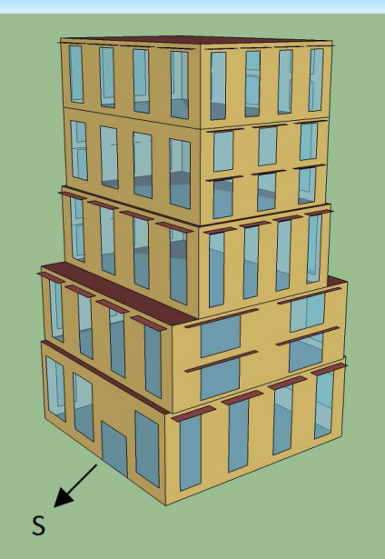
Passive Solar Building Design Using Genetic Programming
M. Mahdi Oraei Gholami
Brock University
Dept. of Computer Science
500 Glenridge Ave.
St. Catharines, Ontario
L2S 3A1, Canada
mahdi.oraei@gmail.com
Brian J. Ross
Brock University
Dept. of Computer Science
500 Glenridge Ave.
St. Catharines, Ontario
L2S 3A1, Canada
bross@brocku.ca
GECCO 2014

Slide 2
Introduction
Passive solar building design goals:
Collect heat in winter
Reject heat in summer
No mechanical system
How to design a building?
Computer aided design
Interactive evolutionary systems
Automated evolutionary systems

Slide 3
Introduction
What affects a building design?
Building location
Local climate
Materials
Window and Shading: size and placement.
Budget

Slide 4
Objectives
Objectives
Building designs having good solar performance
Performance may include...
Cooling energy
Heating energy
Window heat gain
…

Slide 5
Approach
CFG-based system
Modeling language.
Building shape and size.
Door and window.
Materials.
Genetic programming
Implements split grammar ideas and CFG expressions.
EnergyPlus
Simulate and analyze all aspects of the building.

Slide 6
Conflicting objectives
Heat Gain
windows allow sunlight to heat interior in winter but results in air conditioning cost in summer
Heat Loss
windows lose heat at night, which requires additional heating expense

Slide 7
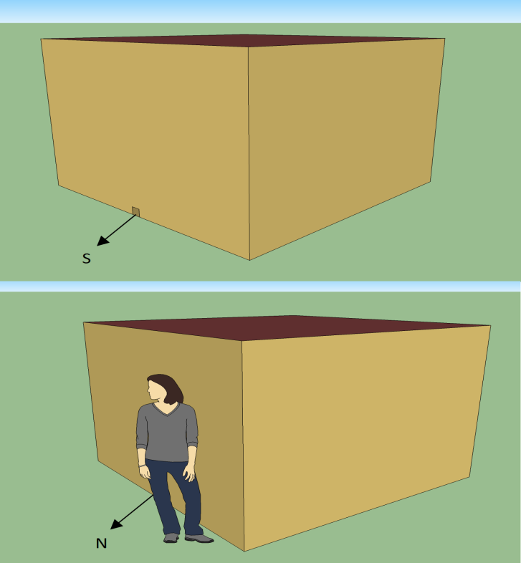
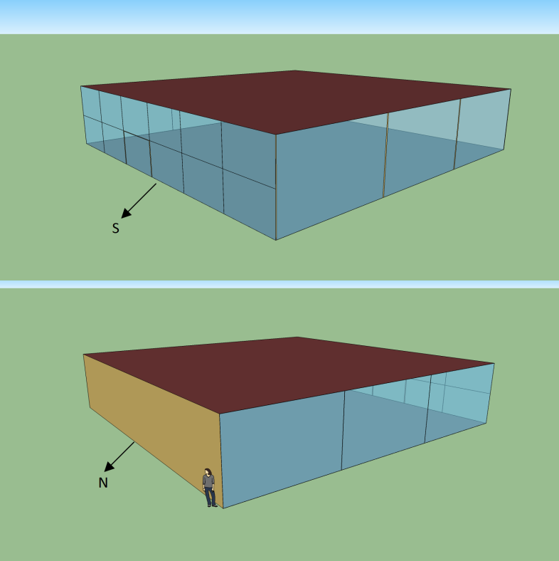
Single-objective evolution
Minimize Energy Usage
small insulated shack with no windows and small door is very efficient to heat and cool.
Maximize solar heat gain
Maximizes sun intake with its walls of windows on the east, south, and west sides.

Slide 8
Background

Slide 9
Evolutionary Design
Evolutionary design is the application of evolutionary computation in designing forms.
Architecture, art, engineering, etc.

Slide 10
Design Language
Context free grammar design language.
Strongly typed GP.
Split grammar: simplified shape grammar
Some aspects (roofs, windows,...) based on split grammar approach.

Slide 11
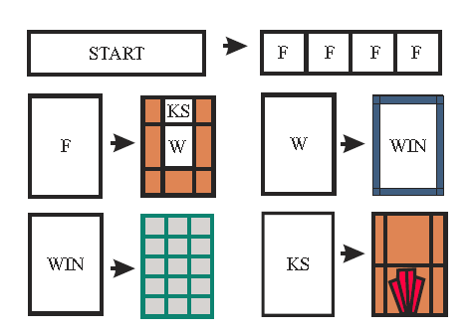
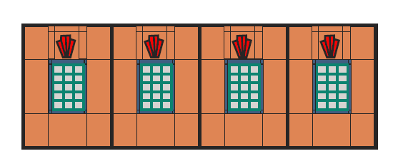
Split Grammar
Rules:
Result:
Taken from [21]

Slide 12
Energy Efficiency
Reducing the cost and the amount of energy, specially non-renewable energies, that is needed for providing services and products.
Practical result
Saving energy
Pollution is reduced.
Reducing noise of mechanical devices.

Slide 13
Energy Plus

Slide 14
EnergyPlus
EnergyPlus is a free energy simulation, load calculation, building and energy performance, heat and mass balance application.
http://apps1.eere.energy.gov/buildings/energyplus/

Slide 15
EnergyPlus Input
1. Input data file (IDF)
Materials, and Constructions
Geometry: place and size of walls, roofs, floors, doors, windows, and overhang
Lights & Electrical equipment
Ideal Loads Air System
2. Weather file (EPW)
Temperature
Latitude, longitude
wind, rain, snow
... and lots more!

Slide 16
EnergyPlus Output
Annual Building Utility Performance
Total energy
Heating
Cooling
Geometric characteristics:
Building area
Window area
Wall area

Slide 17
Literature Review

Slide 18
Evolutionary Design and Energy Efficient Architecture
Malkawi et al. (2005) : Windows, supply airs ducts, and return air ducts placement.
Marin et al. (2008): Winter comfort.
Caldas (2008) : Sustainable energy-efficient buildings.
Turrin et al. (2010) : Large roofs structures.
Harrington (2012) : Summer and winter comfort.

Slide 19
Methodology

Slide 20
System Overview
ECJ : evolutionary system
GP: Strongly typed
CFG-guided design language with split grammar functions.
Energy Plus: simulation and analysis system.
Multi-objective technique: normalized rank-sum

Slide 21
Multi-Objective Techniques Comparison
Fitness | Pareto Ranking | Ranks | NRS
(33,0,125,39) | 1* | (3,1,6,3) | 2.27
(30,24,38,18) | 1* | (2,3,3,2) | 1.4
(0,47,43,18) | 1* | (1,4,4,2) | 1.73
(78,62,2,0) | 1* | (6,6,1,1) | 1.37*
(43,19,20,79) | 1* | (4,2,2,4) | 1.47
(55,55,89,80) | 2 | (5,5,5,5) | 2.67

Slide 22
GP Types and Functions
Type | Function
R | Add Root(S)
S | Add Cube(D,D,D,FF), Add Cube(D,D,D,F)
FF | First Floor(DG,G,G,G,R2,I)
F | Add Floor(G,G,G,G,R2,I)
DG | Add Door Grid(I,I,I,d,W,I)
G | Add Grid(I,I,W,I), Add Empty Grid(I)
DR | Add Door(D,D,I,I)
W | Add Window(D,D,I)
W | Add Window Overhang(D,D,D,D,D,I)

Slide 23
GP Types and Functions ( cont.)
Type | Function
R2 | Add Simple Roof(I), Add Skylight(G)
R2 | Add Gabled Roof(I,G,G,D)
R2 | Add Gabled Roof2(I,G,G,D)
D (& I) | Avg(D,D),Max(D,D), Min(D,D), Mul(D,D), Div(D,D), IfElse(D,D,D,D), ERC
D | Half(D), halffwd(D)
I | Inc(I), dec(I)

Slide 24
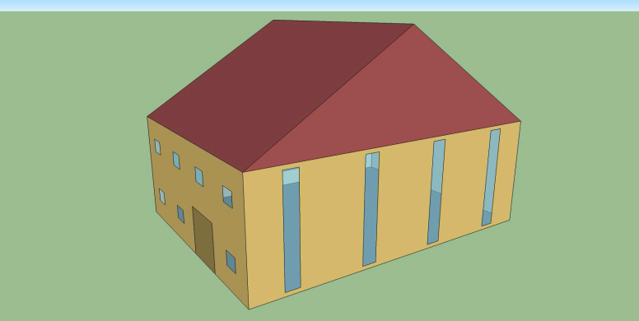
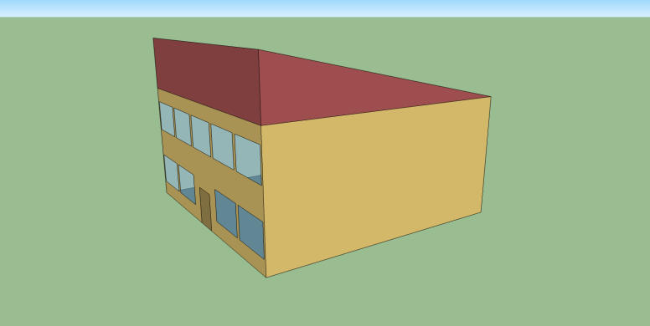
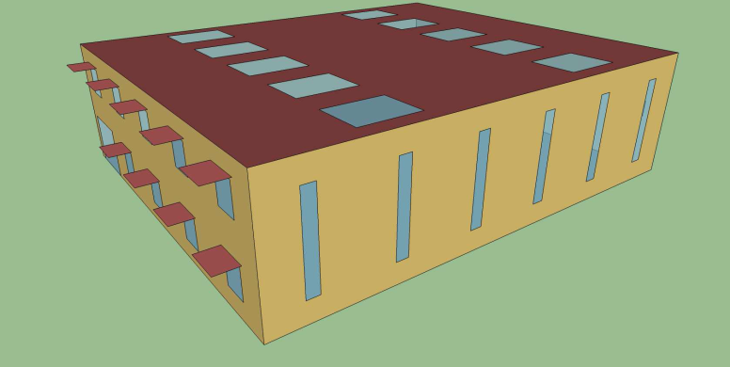
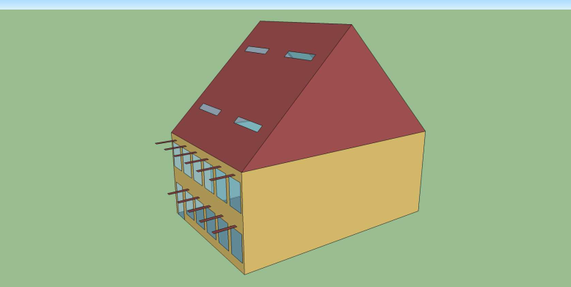
Roof, Overhangs, Skylights.
(a) Gabled roof 1.
(b) Gabled roof 2.
(c) Overhangs and skylights.
(d) Gabled & Skylight roof.

Slide 25
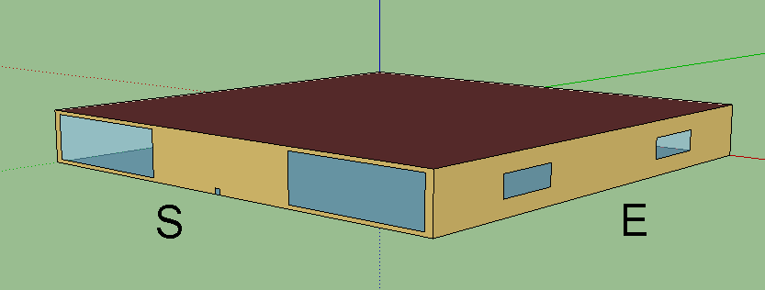
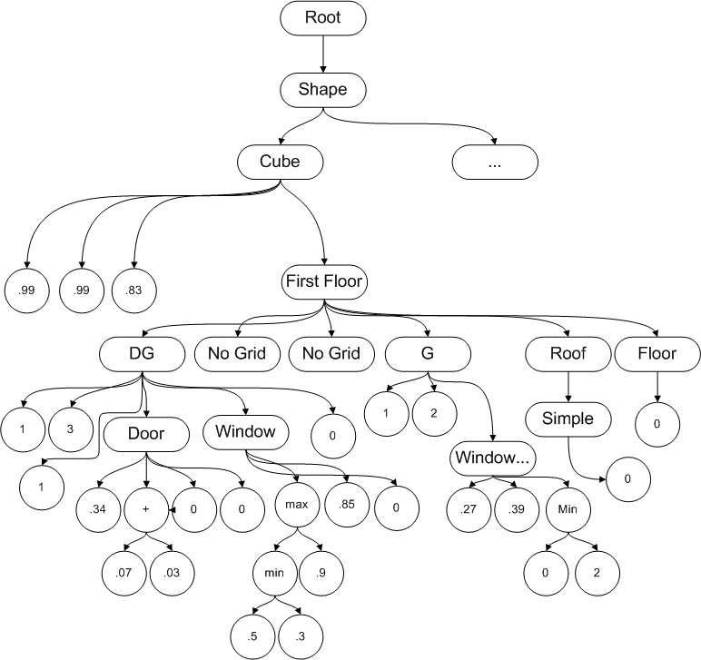
Building Model and Its Grammar Tree.

Slide 26
Constraints
Some of the constraints are as follows:
Min/max size limits
No interior design
symmetric window placement per wall

Slide 27
Experimental Setup

Slide 28
GP Parameters
Parameter | Value
Number of Runs | 10
Generations | 100
Population Size | 300
Initialization Method | Half-and Half
Tournament Size | 3
Crossover Rate | 90%
Mutation Rate | 10%
Elitism | 2
Grow Tree Max Depth | 6
Grow Tree Min Depth | 2
Full Tree Max Depth | 12
Full Tree Min Depth | 5

Slide 29
Design Parameters
Parameter | Value (m)
Max/Min Floor Length | 20/10
Max/Min Floor Width | 20/10
Max/Min Floor Height | 8/4
Maximum Number of Rows on a Façade | 2
Maximum Number of Columns on a Façade | 6
Max/Min Door Height | 8/2
Max/Min Door Width | 6/1
Max/Min Roof Height | 10/3

Slide 30
Materials
Construction | Material | U-factor
Wall_1 | Wood, fiberglass quilt, and plaster | 0.516
Wall_2 | Wood, plywood, insulation, gypsum | 0.384
Wall_3 | Gypsum, air layer with 0.157 thermal resistance, gypsum | 1.978
Wall_4 | Gypsum, air layer with 0.153 thermal resistance, gypsum | 1.994
Wall_5 | Dense brick, insulation, concrete, gypsum plaster | 0.558
Roof_1 | No mass with thermal resistance 0.65 | 1.189
Roof_2 | Roof deck, fiberglass quilt, plaster | 0.314
Roof_3 | Roof gravel, built up roof, insulation, wood | 0.268
Floor_1 | Concrete, hardwood | 3.119
Floor_2 | Concrete, hardwood | 3.314

Slide 31
Window and Door Materials
Construction | Material | U-factor | SHGC
Window_1 | 3 mm glass, 13 mm air, 3 mm glass | 2.720 | 0.764
Window_2 | 3 mm glass, 13 mm argon, 3 mm glass | 2.556 | 0.764
Window_3 | 6 mm glass, 6 mm air, 6 mm glass | 3.058 | 0.700
Window_4 | 6 mm low emissivity glass, 6 mm air, 6 mm low emissivity glass | 2.371 | 0.569
Window_5 | 3 mm glass | 5.894 | 0.898
Window_6 | 6 mm glass | 5.778 | 0.819
Door_1 | 4 mm wood | 2.875 | -
Door_2 | 3 mm wood, air, 3 mm wood | 4.995 | -
Door_3 | Single layer 3 mm glass | 5.894 | 0.716

Slide 32
Different Geographical Locations Experiment

Slide 33
Different Geographical Locations
Toronto, Canada
(baseline) humid continental
Anchorage, Alaska
northern subarctic.
Eldoret, Kenya
equatorial, tropical.
Las Vegas, USA
subtropical, hot desert.
Melbourne, Australia
southern hemisphere, temperate.

Slide 34
Objectives
1- Window heat gain in winter.
2- Annual cooling and heating energy consumption.
3- Window constraint: having at least 25% window area.
$$SOE=\sum_{i}{{\left(0.25 −\frac{window area}{wall area}\right)}^{2}}$$

Slide 35
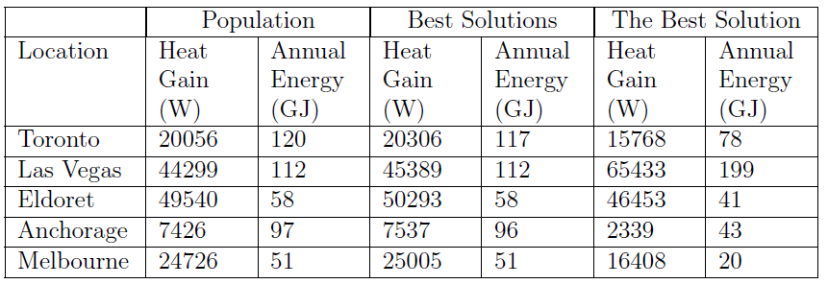
Results

Slide 36
Window Area Analysis
Location | South | West | North | East
Toronto | 94 | 27.5 | 24 | 35
Las Vegas | 87 | 28 | 25 | 28
Eldoret | 45 | 52.5 | 27.5 | 55
Anchorage | 89 | 26 | 22.5 | 28
Melbourne | 25 | 29 | 81.5 | 38
Window area percentage of top solutions.
Window Placement:
North hemisphere: south.
South hemisphere: north.
Near equator: east and west.

Slide 37
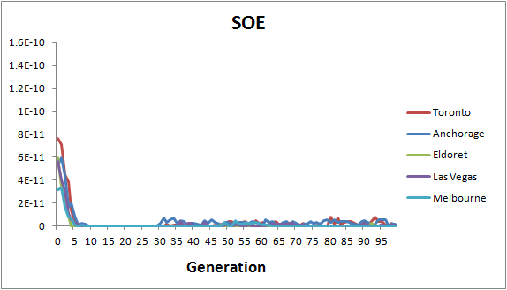
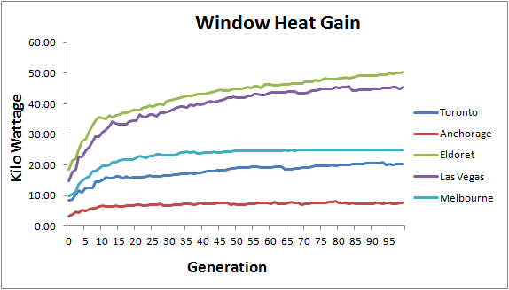
Performance Plots

Slide 38
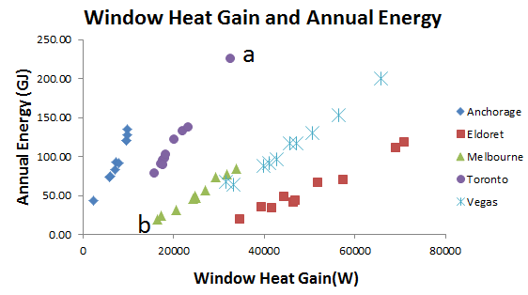
Scatter Plot

Slide 39
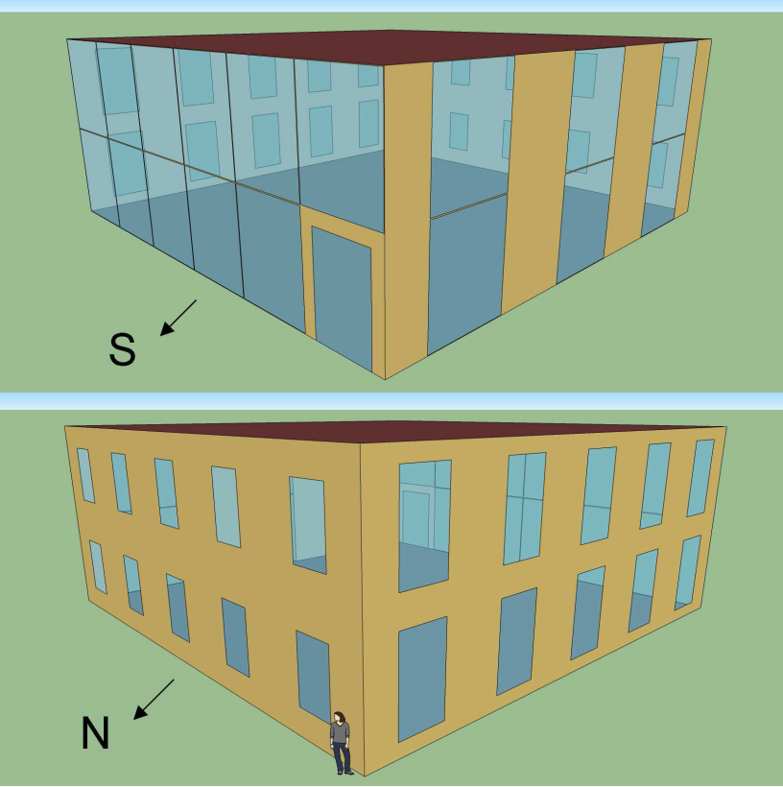
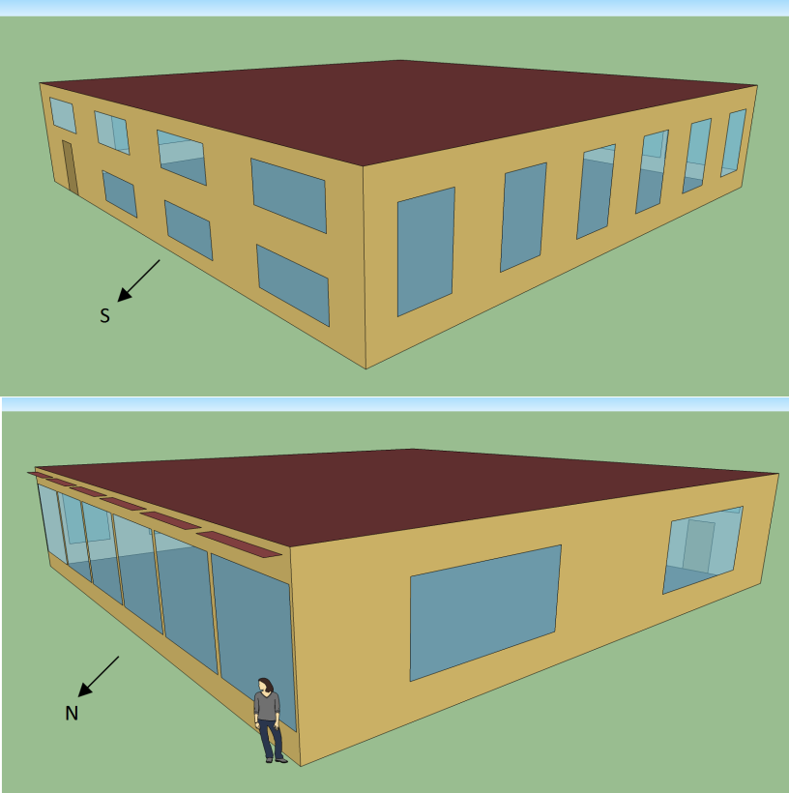
Scatter Plot (cont.)
a- Worst model (Toronto)
b- Best model (Melbourne)

Slide 40
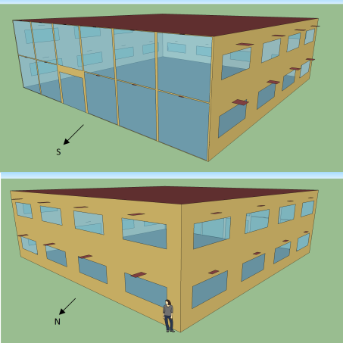
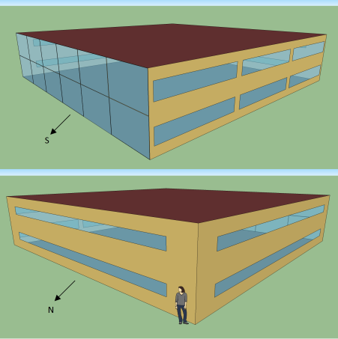
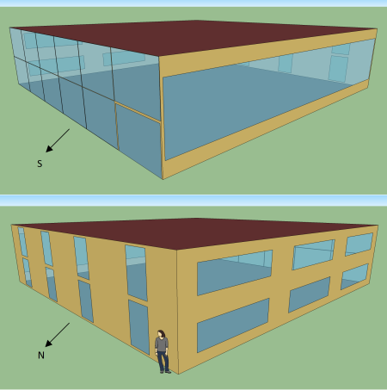
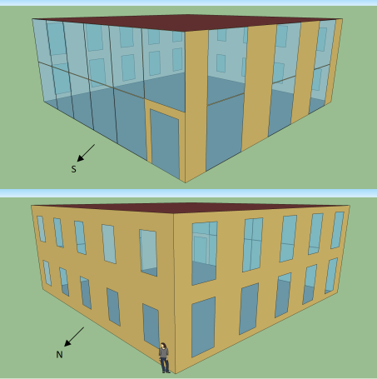
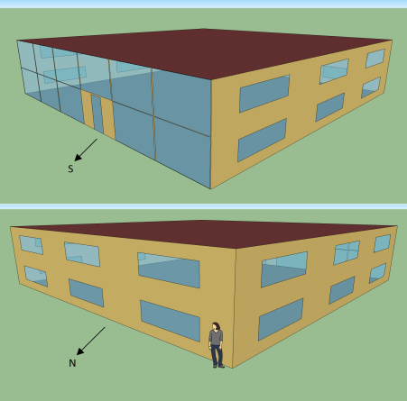
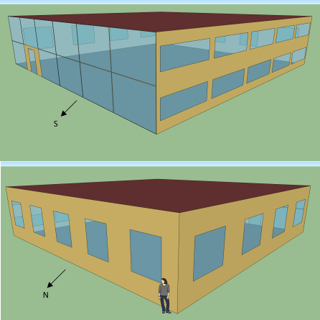
Consistency: Toronto Models

Slide 41
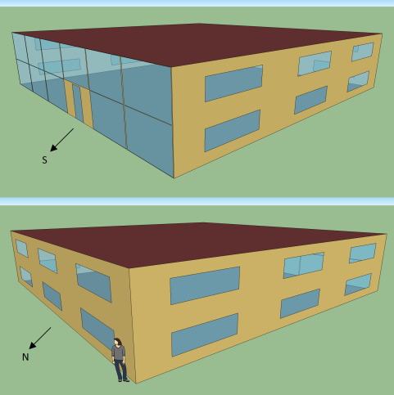
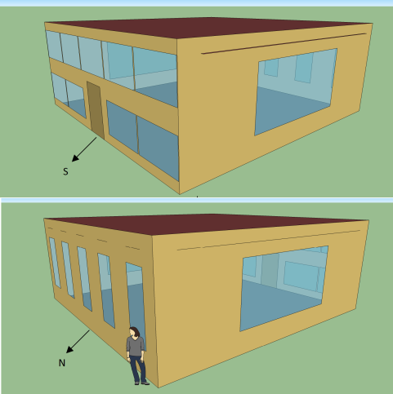
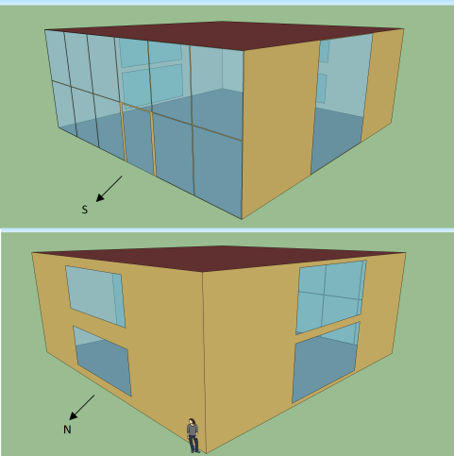
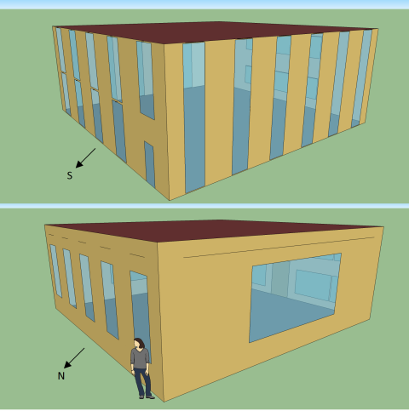
Best Models
Toronto
Anchorage
Las Vegas
Eldoret
Melbourne

Slide 42
Best Models Analysis (cont.)
Neither skylights nor complex roofs are selected.
Annual energy consumption increases in either cases.
larger roofs = increased room volume
Size:
Maximum length
Maximum width.
Height changes based on the location.
Materials:
Walls: third lowest U-factor.
Double pane windows with argon
Second lowest in U-factor and the best in SHGC
Floors and Roofs: biggest U-factor

Slide 43
Multi-Floor Experiment

Slide 44
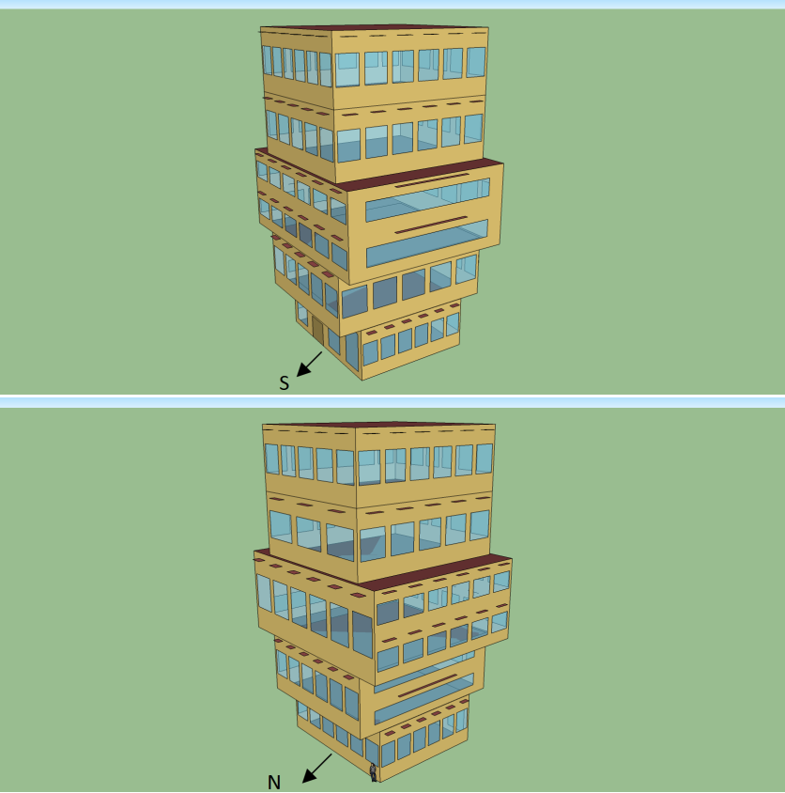
Stylistic multi-floor buildings
Building name: Statoil Headquarters
Location: Fornebu, Norway.
Designed by: A-lab

Slide 45
Multi-floor Experiment
Objectives:
Window heat gain in winter
Annual cooling and heating energy consumption.
Exactly 35% window area.
Each floor has to be 15% smaller than the floor underneath.
Total volume has to be $10000m^{3}$
Location: Toronto

Slide 46
Multi-floor Experiment
Results:
More energy consumption than when either window constraint or volume constraints are not considered.
Less window heat gain than when window constraint is not considered.
Without window constraint: volume constraints are met easier.
Without volume constraints: window constraint is met easier.

Slide 47
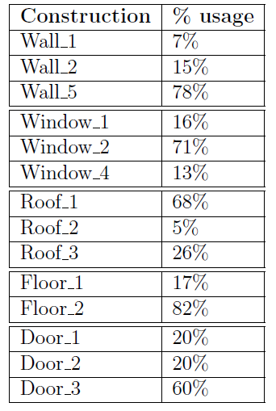
Multi-Floor Experiment
Materials:

Slide 48
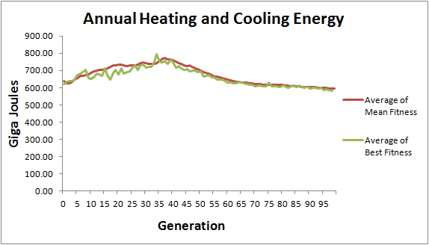
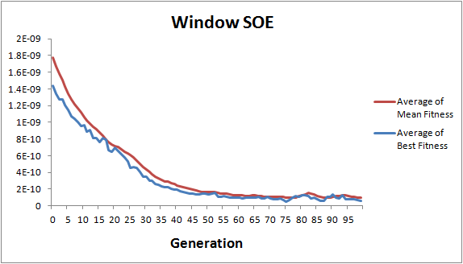
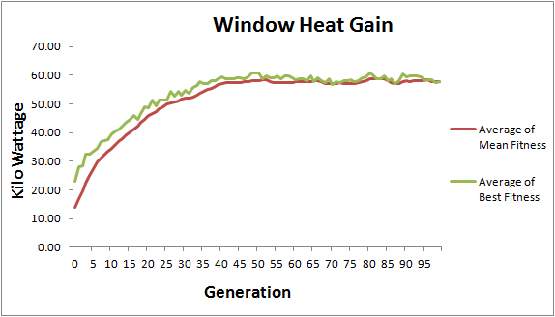
Performance Plots

Slide 49
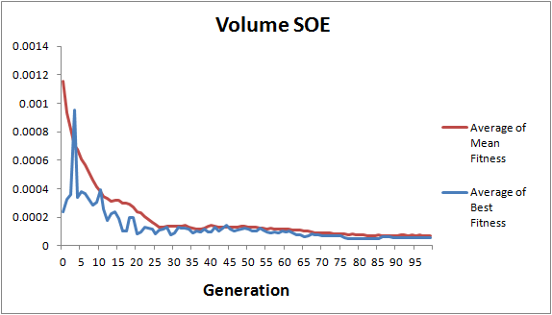
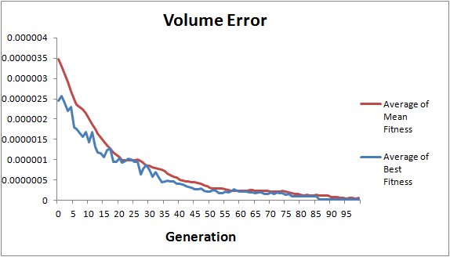
Performance Plots

Slide 50
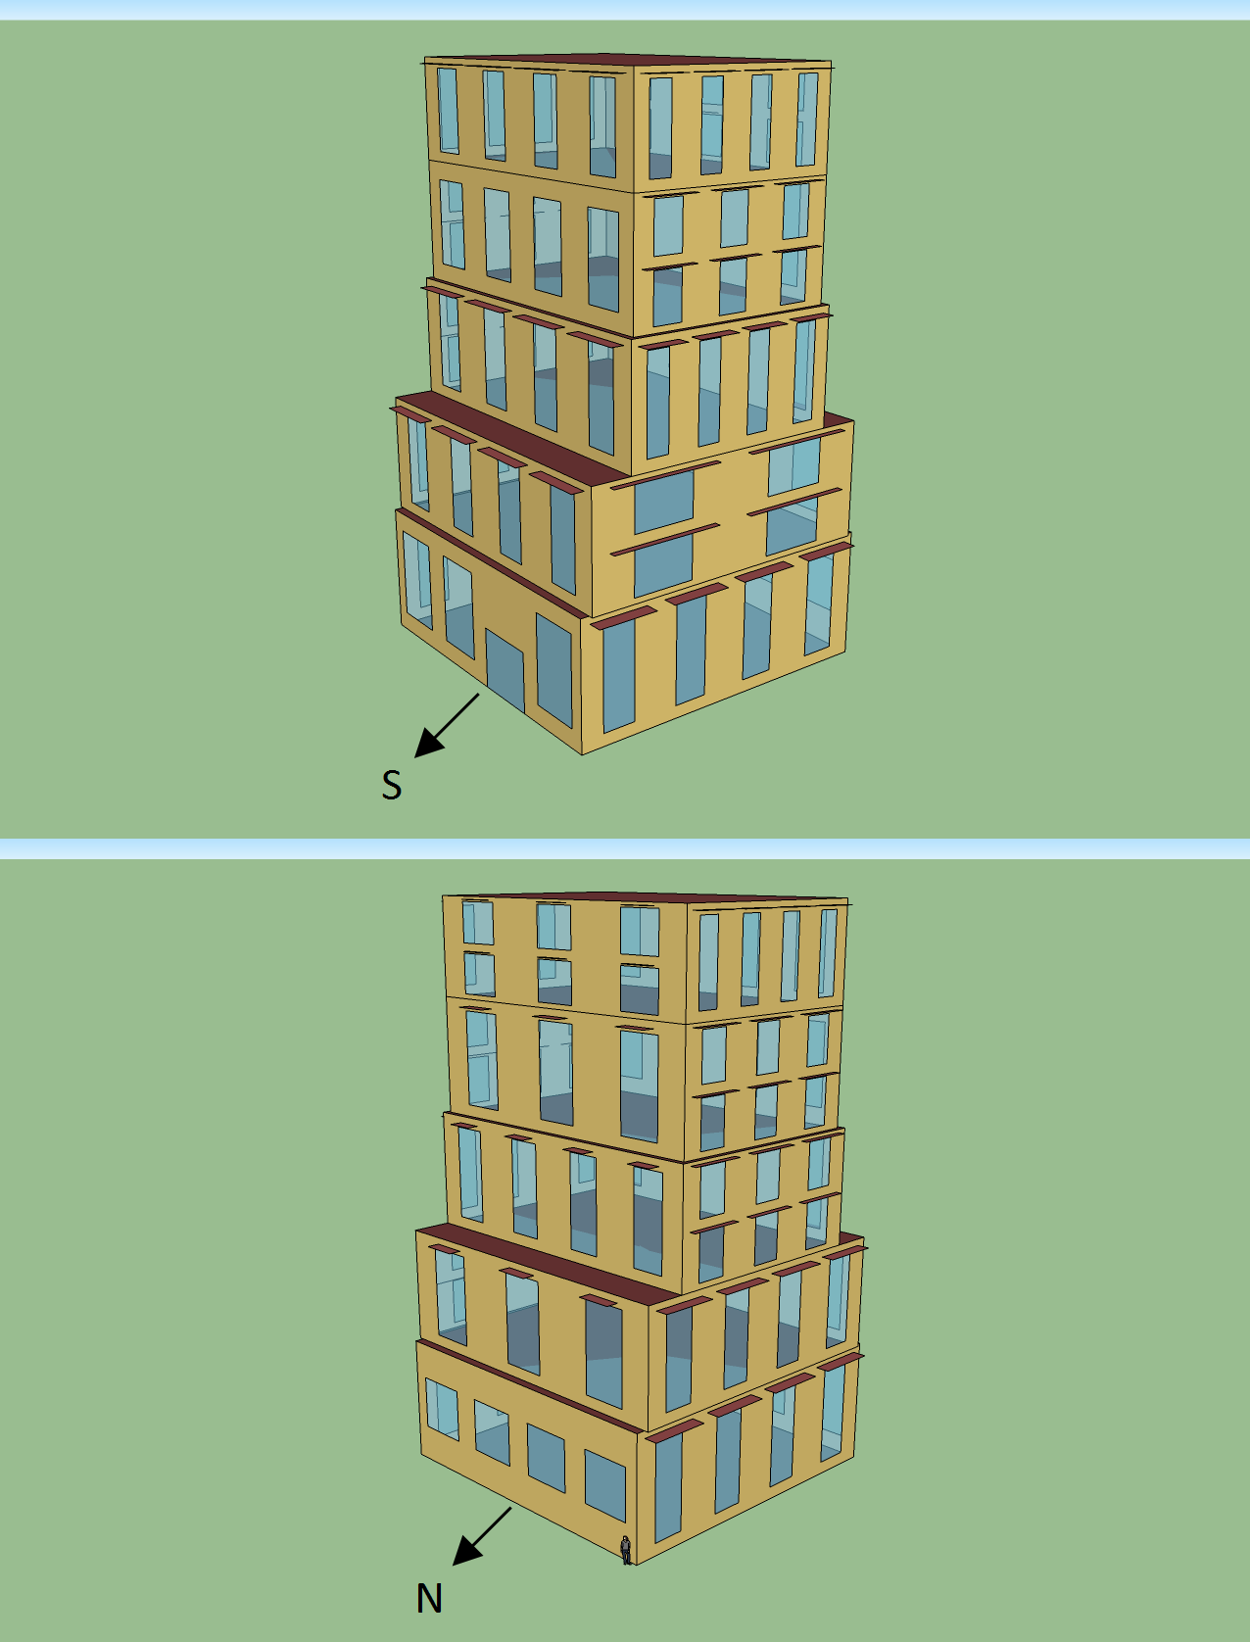
The Best Model

Slide 51
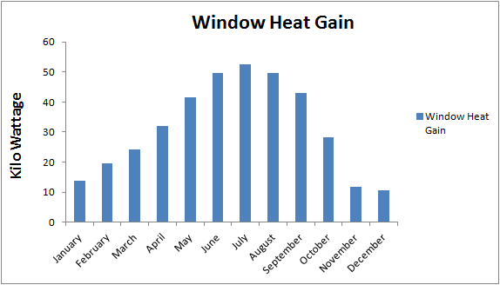
The Best Model Heat Gain and Annual Energy

Slide 52
Discussion
A comparison to Caldas (2008) work:
Similarities:
Materials, roofs, doors, overhangs, and windows are considered in both.
Multi-objective approach.
Both have the problem of no window when only energy consumption is considered.
Differences:
Illumination vs. window heat gain
DOE2 vs. EnergyPlus
GA vs. GP
Two objectives vs. five objectives
Pareto ranking vs. normalized rank sum

Slide 53
Conclusion
Evolutionary design (GP)
Highly performance building design
CFG based grammar guided system
Walls, floors, roofs, windows, overhangs, materials
Grammars were straightforward for our purpose
EnergyPlus
Simulation and analysis system.
Worked well, although it is not designed to be used in batch mode with 1000’s of simulations!

Slide 54
Conclusion
Multi-Objective
Normalized rank sum worked well with even 5 objectives.
Trade-off of objectives: Energy objectives treated “equally”, with no preferred biases.
Consistent solutions with respect to size, geometry, materials, and design elements are achieved in all experiments.

Slide 55
Thank you

